Slide 1
Implementing a cross platform compiler for mobile applications
By
Gokulnath.p (192121156L)
P Venkata Vamsi Krishna (192211431)
N. Ravi Teja Reddy (192210667)

Slide 2

Introduction
Compilers are essential tools in software development, translating high-level programming languages into machine code.
Cross-platform mobile development allows developers to write code once and deploy it across multiple mobile operating systems like iOS and Android.
Cross-platform development reduces development time and costs by eliminating the need for separate codebases for each platform.

Slide 3
Challenges in Mobile App Development
Platform Fragmentation
The wide variety of mobile devices, operating systems, and screen sizes leads to fragmentation, making it challenging to ensure consistent app performance and compatibility across devices
UI Consistency
Maintaining a consistent user interface (UI) across different platforms and devices while adhering to platform-specific design guidelines can be complex and time-consuming.
Performance Issues
Mobile apps often face performance challenges due to limited resources such as CPU, memory, and battery life. Optimizing apps to run smoothly on all devices is a significant challenge.
.

Slide 4

Cross-Platform Development Approaches
The diversity of mobile devices and operating systems creates fragmentation, requiring developers to adapt apps for various screen sizes, hardware capabilities, and OS versions.
Mobile apps must deliver smooth performance despite limited resources like CPU, memory, and battery. Optimizing apps to run efficiently across devices is a significant challenge.

Slide 5
Design Considerations for a Cross-Platform Compiler
Language Support
The compiler should support popular programming languages used in mobile app development, such as Java, Kotlin, Swift, and JavaScript, to cater to a wide range of developers.
Code Abstraction
The compiler should abstract platform-specific code to enable developers to write code once and deploy it across multiple platforms, reducing redundancy and simplifying maintenance.
Reusability
The compiler should facilitate code reusability by providing mechanisms for sharing common code components across different platforms, improving development efficiency and consistency.

Slide 6
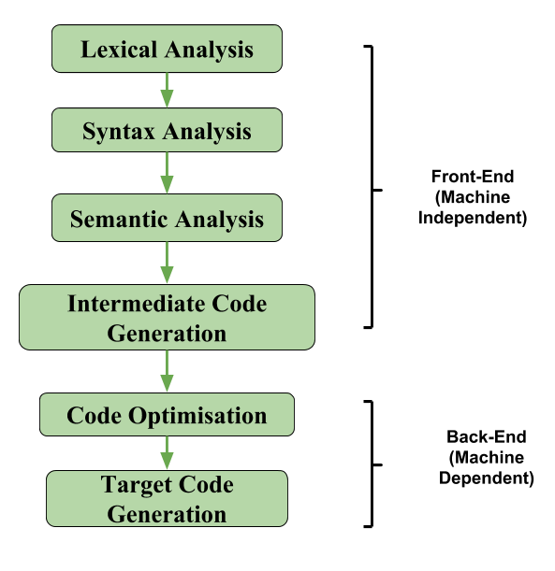
Architecture of the Compiler
Front-End
The front-end of the compiler is responsible for lexical analysis, syntax analysis (parsing), and semantic analysis. It processes the source code and generates an intermediate representation (IR) of the program.
Intermediate Representation (IR)
The IR is a platform-independent representation of the source code. It serves as a common format for analysis and optimization before code generation.
Back-End Components
The back-end of the compiler takes the IR and performs optimization and code generation specific to the target platform. It generates the machine code or bytecode that can be executed on the target platform.

Slide 7

Handling Platform-Specific Challenges
Different devices offer unique features (e.g., camera, GPS) that require platform-specific implementation. The compiler should provide mechanisms to access these features uniformly across platforms.
Mobile apps run on various operating systems (e.g., iOS, Android). The compiler should handle OS-specific behaviors and requirements to ensure consistent app functionality across different platforms.
Each platform has its set of APIs for accessing system functions. The compiler should abstract these APIs to enable developers to use them without worrying about platform differences.

Slide 8



Testing and Debugging Strategies
Cross-Platform Testing Tools
Utilize cross-platform testing tools like Appium, Xamarin.UITest, or Test Project that allow you to write and execute tests across multiple platforms using a single codebase.
Testing Techniques
Employ techniques such as automated UI testing, unit testing, and integration testing to ensure the functionality and compatibility of your app across different platforms.
Debugging
Use platform-agnostic debugging tools like Chrome DevTools for web-based apps or Xcode and Android Studio for native apps to identify and resolve issues across platforms.

Slide 9



Performance Optimization Techniques
Battery Consumption
Reduce unnecessary background processes, optimize network requests, and use energy-efficient programming practices to minimize battery consumption and improve the overall user experience.
Code Efficiency
Optimize algorithms and data structures to reduce computational complexity and improve the overall efficiency of the code.
Memory Management
Use efficient memory management techniques such as object pooling, lazy loading, and minimizing memory leaks to optimize memory usage and improve app performance.

Slide 10
References
Xamarin. (n.d.). Cross-platform mobile development with Xamarin. Retrieved from https://dotnet.microsoft.com/apps/xamarin
Flutter. (n.d.). Get started with Flutter. Retrieved from https://flutter.dev/docs/get-started/install
React Native. (n.d.). Learn once, write anywhere. Retrieved from https://reactnative.dev/
"Cross-Platform Development Approaches for Mobile Applications: A Comparative Study." (2019). IEEE Access, 7, 101585-101602.
Vos, T., & Koolen, M. (2018). "A Comparative Study of Cross-Platform Development Approaches for Mobile Applications." In 2018 25th Asia-Pacific Software Engineering Conference (APSEC) (pp. 297-304). IEEE.

Slide 11


